Slide 1


Sports Analytics is HOT Module 2
Dr. Dave Schrader
Teaching Module For Teradata University Network
Send Questions or Comments to drdaveschrader@gmail.com

Slide 2
THIS IS MODULE 2
There are two versions of the materials
You can pull the “Overview Deck” which has all the slides in one place
Or – you can access 6 modules that carve the material up
#1 – Sports is Big Business
#2 – Sports Analytics is HOT
#3 – Sports Analytics for Business Operations
#4 – Sports Analytics for Team Operations
#5 – Sports Analytics for Training, Health, and Safety
#6 – How to Get a Job in Sports Analytics

Slide 3
Sports Analytics:
Why? Many believe that – just like in Business – using analytics will provide a competitive edge, deeper insights on players and teams, and drive increased revenues or decreased costs. As a result:
Pro teams (and college teams) are adding analytics staff
More analysis is happening in both the front-office (marketing, sales) as well as the back-office (coaching and training) job functions. More people are using data/insights to guide daily operations.
The number of conferences on sports analytics is growing rapidly!
The Field is HOT
Topic 2
Notes:
Teaching Notes for Sports Analytics
Module 2 – Sport Analytics is HOT (PowerPoint)
Provided by Dr. Dave Schrader, drdaveschrader@gmail.com
Motivation: The purpose of this module is to define the categories of sports analytics and help students understand the kinds of decisions that can be improved with data collection and analysis.
The educational goals for this module include:
Students should be able to distinguish between 2 kinds of sports analytics.
The first is “Business Operations (or front office) analytics” which you will recognize as variations of traditional topics in marketing analytics – fan engagement, social media, fan sentiment, ticket pricing and bundling.
The second, and newer area, is “Team Operations analytics”, which focuses on player, trainer, and coach uses of analytics. With the advent of wearables and video, the sports analytics field is about to make quantum strides, so this topic is “hot”.
Students should be able to go discover more examples online about decision-making with data and analytics for their favorite sport, and be able to catalogue the examples they find as Business Ops or Team Ops.
Students should read the Tom Davenport white paper, which sets up Modules 3 and 4.
This page addresses WHY analytics is important – and a “hot topic”. The answer is getting a competitive edge (just like in business) in a variety of areas – both business and team operations. Everybody can benefit from data and data analytics.

Slide 4
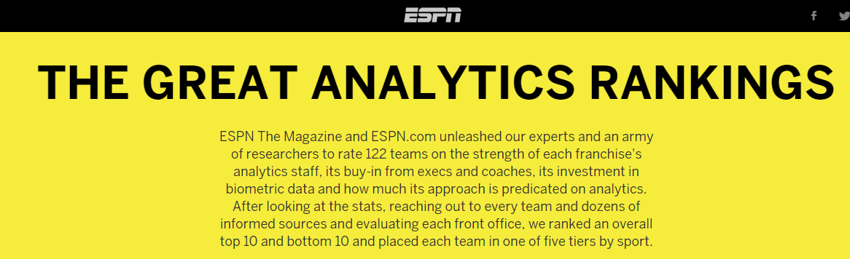
Practically every pro team has launched analytics efforts
ESPN (a huge media organization) is now even rating which teams are ahead and which are behind. Click the link to see how your favorite team stacks up!
Source: http://espn.go. mco/espn/feature/story/_/id/12331388/the-great-analytics-rankings/
Notes:
Most of the pro teams are adding analytics staff. Data collection and insight generation is viewed now as a competitive edge. That’s one reason why this is an interesting area – it’s just like where the business world was 10 years ago when Tom Davenport wrote Competing on Analytics (which I assume you know as a landmark book in analytics). While most teams are not eager for competitors to know what they are doing (just like many businesses don’t want people to know their secret sauces), there is enough information for ESPN to write an article on which teams are “with the analytics program” and which are behind. It’s also the case that each sport is at a different point of maturity with regard to the adoption of analytics. You might ask the students to guess which sports are “ahead” and “which are behind”. You can give a homework assignment from this page for students to go find out the answer for their favorite sport – who is behind and who is ahead, and why?

Slide 5
Who Can Benefit from Data/Analytics? Everybody in the Sport Eco-system
Back Office
Agents
Trainers
Equipment Managers
Scouts
Players
Coaches
You can adapt the labels for each sport, but they have more similarities than differences
Fans
Teams
Opponents
Social Media
Owners
Leagues
Referees
Marketing
Sales
Venue
Operations
Finance
Logistics
Front Office
Notes:
the more you think about it, the more people need to use data to do their daily job. Use this page to see if students can come up with examples of how each of these categories of people in the sports ecosystem uses data. Note that most of these positions have analogues in every sport – so their use of analytics is a transferable skill.

Slide 6
Sample Decisions – Business Operations
How much should we charge for tickets? Box suites? Static or dynamic pricing?
What giveaways might drive up attendance and sales?
How do we engage fans more? Mobile? Web?
How much money can we earn from TV coverage?
How much to spend on spot TV advertising?
Which business partners increase sales?
Which players can we afford to draft and keep under the salary cap?
How much should we spend on free agents?
Notes:
if you go back to the previous slide, I’ve laid things out so some of the jobs are “front office” and some are “back office”. There is some “gray” in this picture when it comes to decision-making on salaries, which is a financial decision made by owners and leagues, and which requires both inputs from coaches (e.g., which players they need that fit with their system), trainers (estimates of playing lifetime left). For now, I’ve put “finance” decisions in the front-office bucket, but you could argue with this. So on this page, you have a partial list of the answers to the question of what kinds of decisions using data some of the front-office people need to make. A key point to make is that these are not “new” decisions – they have always been made, but often without the benefit of data/deeper insights.

Slide 7
Sample Decisions – Team Operations
3 Focus Areas: Player acquisition, development, deployment
Who to recruit? Who to cut? Who to trade?
What training approaches work best? How to develop athletes?
Keep them healthy?
What combinations of players have the highest chance of success?
What plays to run under what situations?
What weaknesses do the opponents have, how to exploit?
Notes:
same thing, except now we focus on Team Operations.
A key point to make is that these are not “new” decisions – they have always been made, but often without the benefit of data/deeper insights.

Slide 8
Types of Analytics Shift from History/Stats to Future/Analytics
Descriptive – looking at history
Basketball: does Lebron James usually drive left or right?
Golf: do pro players have a harder time making putts on the last hole of a tournament when it means they will be in/out of the money?
Prescriptive – what’s the future?
American Football: it’s 3rd and 4 on the opponent 20 yard line. What play has the highest likelihood of success?
Hockey: when we have a penalty play with 6 on 5, given this opponent, what combination of players will give the highest probability of success?
Notes:
want to show the difference between Descriptive and Prescriptive analytics. Historically, sports has gathered a lot of stats on what happened, back-wards looking. But just like in the business world, building predictive models is where the value lies. In the examples on this page, I focused on Descriptive and Prescriptive questions for Team Ops. If you want to have a discussion, ask if they could build a similar set of questions for Business Ops. (You could also give this as a homework assignment).

Slide 9
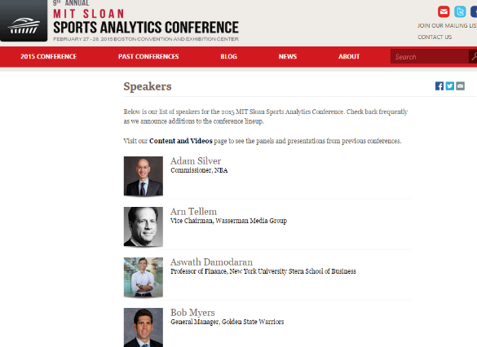
Top Conference - MIT Sloan Sports Analytics Website: http://www.sloansportsconference.com/
MIT Sloan Sports Analytics Conference (SSAC)
9th Annual Conference, February 27-28, 2015
Panels
Research track
Fast growth – 3100 attendees, 1800 on waitlist
A great experience if you can attend, but book early!
Notes:
the MIT conference is the premier conference in the sports analytics area. You should spend some time reading the other modules, taking a look at some of the research papers and videos referenced there before presenting this page

Slide 10
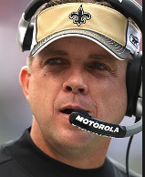
Sample of Hot Topics at the MIT Conference in 2015
Analytics to evaluate (and value) defense. We have a lot of offensive stats but not as many for defense.
Identifying play under pressure. “Clutch”
Player “fit” to systems vs. individual stats
Player safety. Given salaries for pros, what training and rehab promotes longevity? For all levels and all sports, concussion and injury research.
Smarter practices, development. Is less more? How to communicate with players?
Gambling ($1T bet worldwide/year)
Paraphrasing Sean Peyton, coach of the New Orleans Saints football team:
“we can measure workload by position, distance and speeds. It will guide how to practice, how to evaluate players.
For example if a wide receiver runs 6-7 miles in a practice, we know to cut back to avoid muscle pulls and soft tissue injuries. Maybe offensive linemen should not run more than 1.8 miles in a practice.
Maybe we will learn that Wednesdays we should work out with pads for the full 2.5 hours, but on Friday, no pads for only 1.5 hour”
Notes:
highlights some of the “hot topics” at this conference. You can have an in-class discussion about the value of any of these, based on your or student’s knowledge of particular sports or local teams.

Slide 11
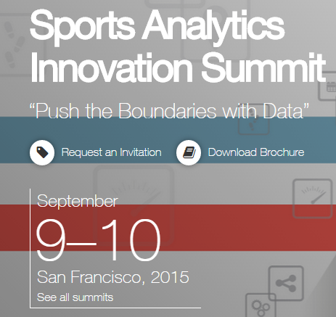
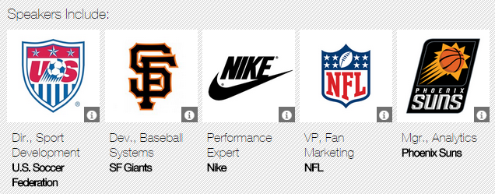
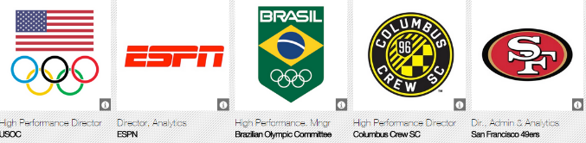
More Conferences : San Francisco
Notes:
just to highlight that there are more and more conferences popping up. It might be the case that you or your students might want to attend one of these in the future. Shows the various teams/organizations who attend.

Slide 12
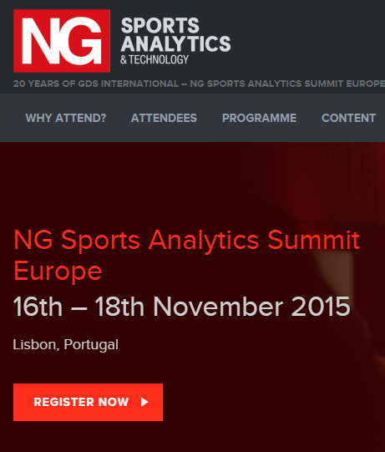
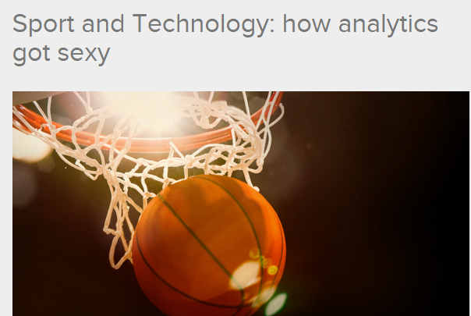
More Conferences: Europe
Source: http://www.gdsinternational.com/events/ngsportsanalytics/eu/
Notes:
It’s not just an American phenomenon. There are conferences happening on all continents. Ask the students to go find the next one coming up, and who is presenting.

